Slide 1
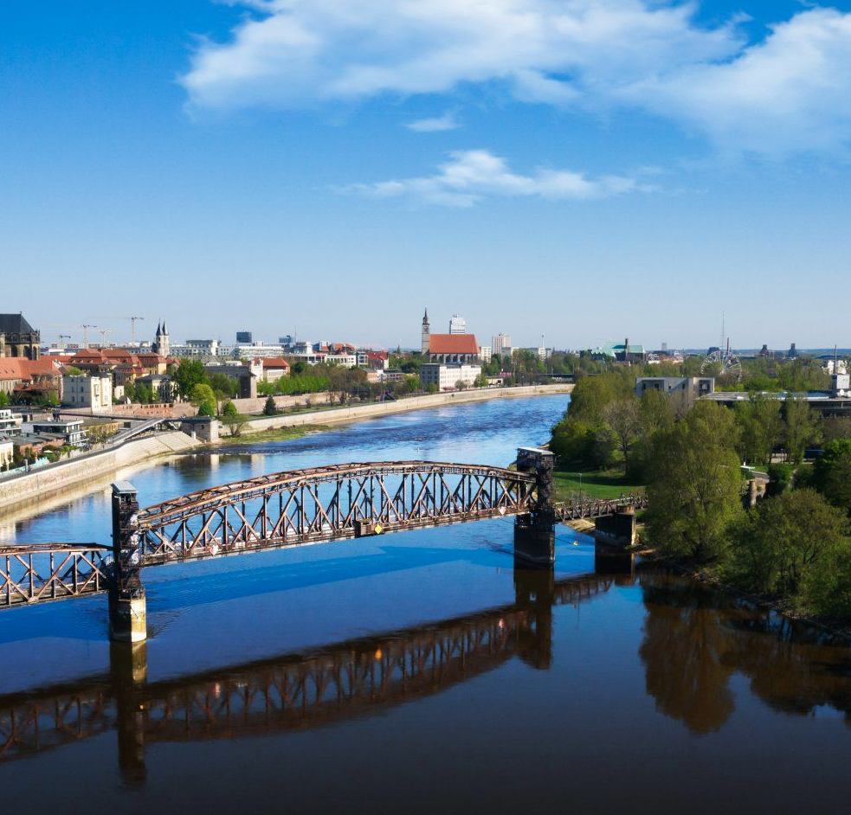
Simulation Project -
Team Tetrahedron
Simulation Project - Team D
Milestone #3 - Conceptual Model
Milestone #3 – Conceptual Model
Image source: https://cdn.ottopix.de/wp-content/uploads/2019/04/Magdeburg-Panorama-%C3%BCber-der-Hubbr%C3%BCcke.jpg

Slide 2
Agenda
01
02
03
04
Simulation Project - Team D
Milestone #3 - Conceptual Model
The Conceptual Model
The Assumptions
An overview of the assumptions made
The abstraction of the node to be simulated
The Data
The Experiments
The data being measured and used as simulation results
An overview of the experiments to be performed

Slide 3
01
The Conceptual Model
Simulation Project - Team D
Milestone #3 - Conceptual Model
The abstraction of the node to be simulated

Slide 4
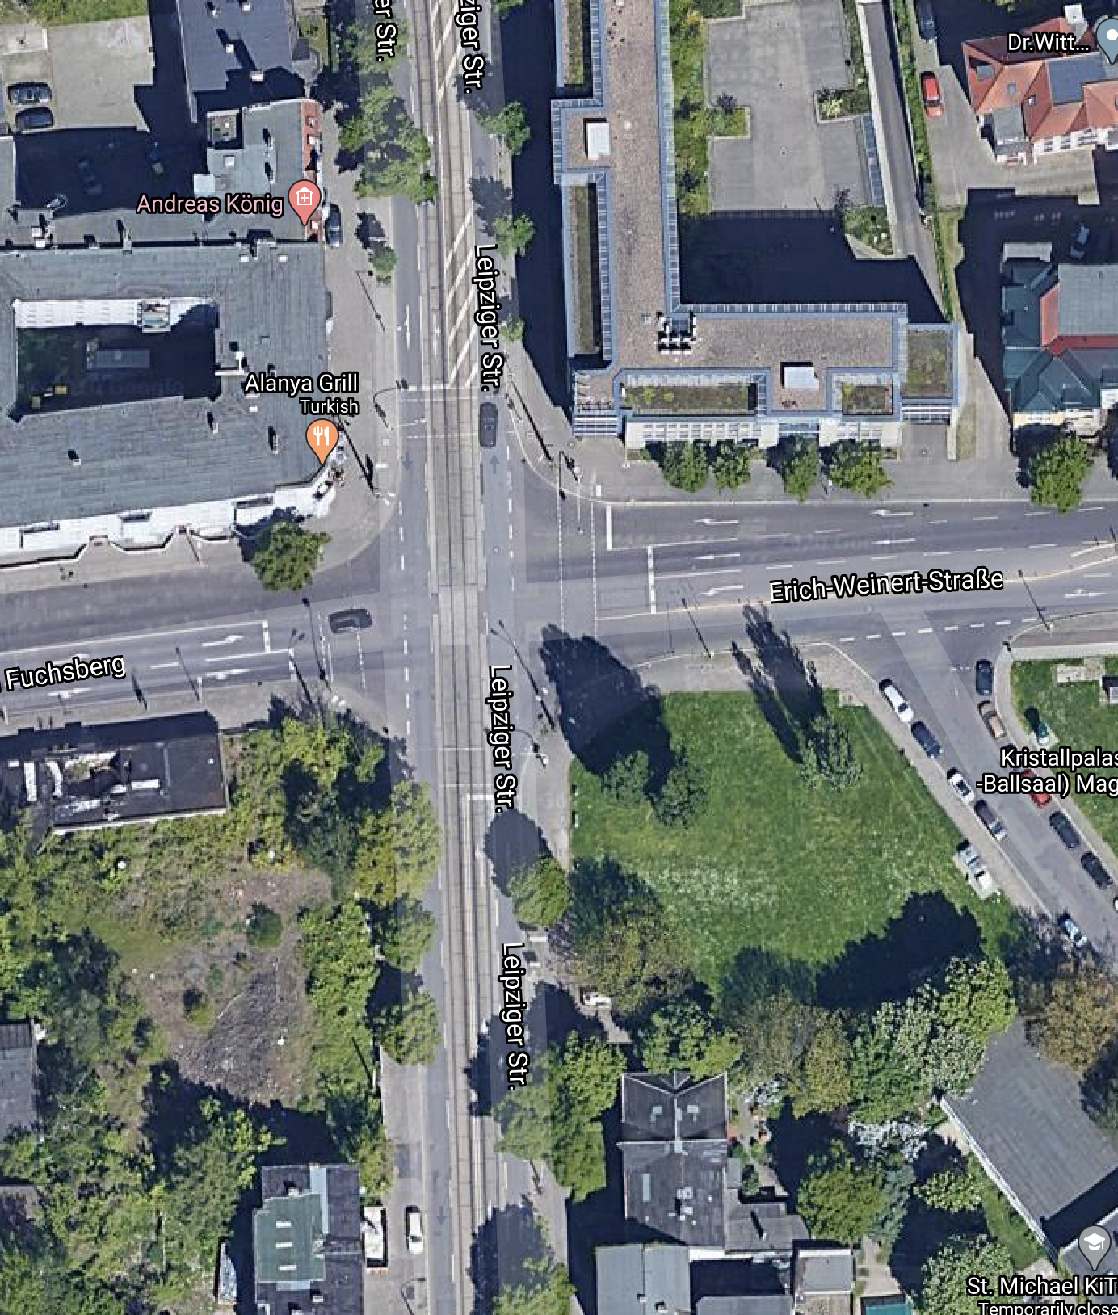
The Node
Simulation Project - Team D
Milestone #3 - Conceptual Model
The node consists of conjunction of 3 different roads.
01
Leipziger Straße from North and South
02
Am Fuchsberg from the West
03
Erich-Weinert Straße from the East

Slide 5
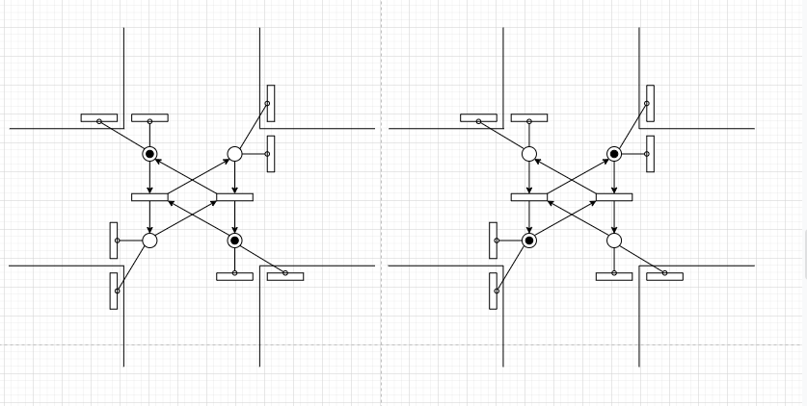
Traffic Phases
Simulation Project - Team D
Milestone #3 - Conceptual Model

Slide 6
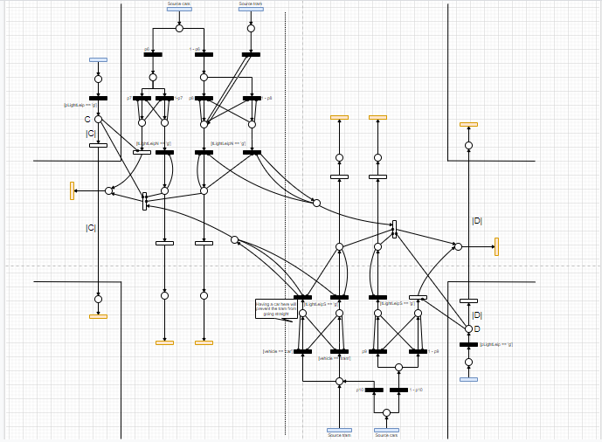
Leipziger Straße(N)- Leipziger Straße(S)
Simulation Project - Team D
Milestone #3 - Conceptual Model

Slide 7
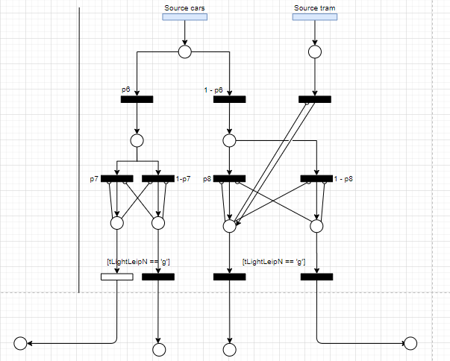
Leipziger Straße(N)
Simulation Project - Team D
Milestone #3 - Conceptual Model

Slide 8
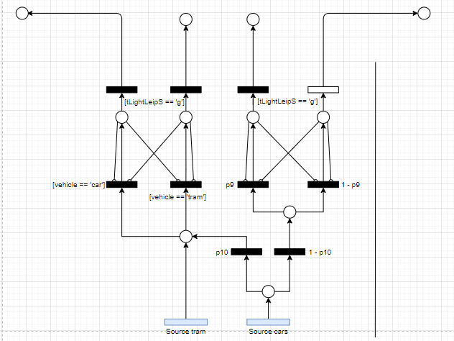
Leipziger Straße(S)
Simulation Project - Team D
Milestone #3 - Conceptual Model

Slide 9
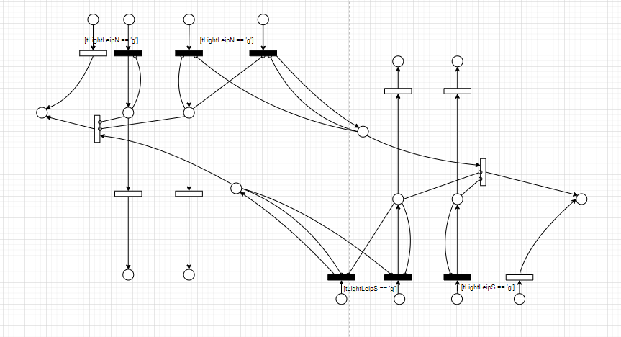
Interactions
Simulation Project - Team D
Milestone #3 - Conceptual Model

Slide 10
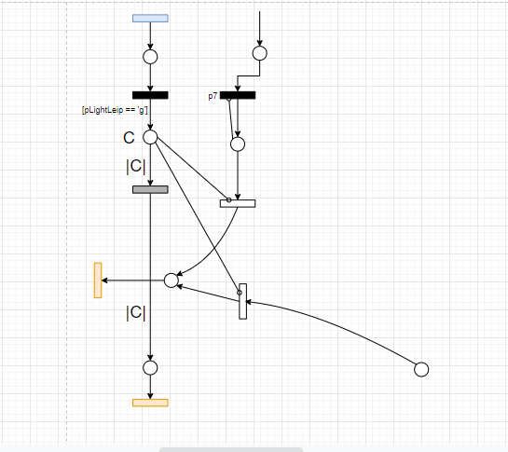
Pedestrians
Simulation Project - Team D
Milestone #3 - Conceptual Model

Slide 11
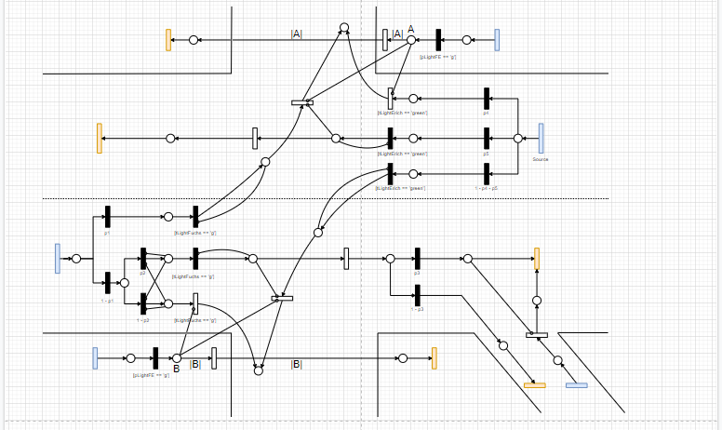
Am Fuchsberg - Erich-Weinert Straße(S)
Simulation Project - Team D
Milestone #3 - Conceptual Model

Slide 12
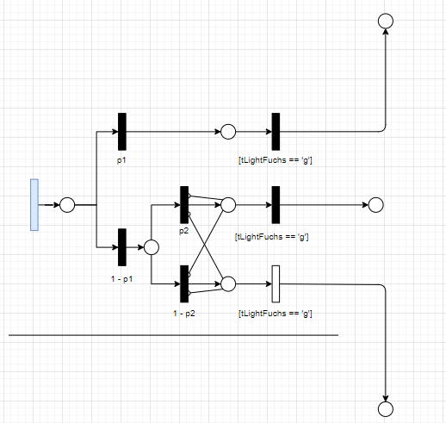
Am Fuchsberg
Simulation Project - Team D
Milestone #3 - Conceptual Model

Slide 13
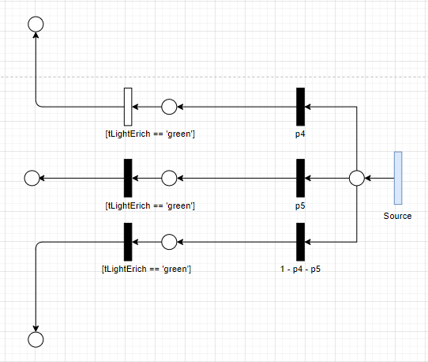
Erich-Weinert Str
Simulation Project - Team D
Milestone #3 - Conceptual Model

Slide 14
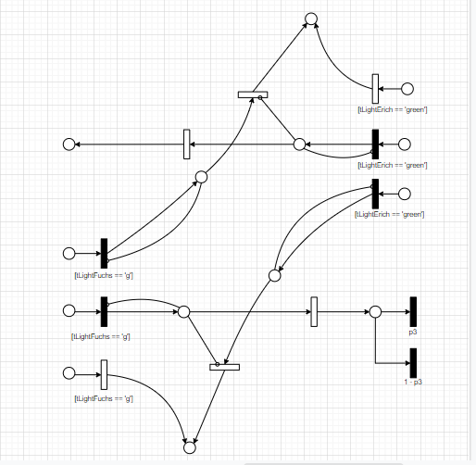
Interaction
Simulation Project - Team D
Milestone #3 - Conceptual Model

Slide 15
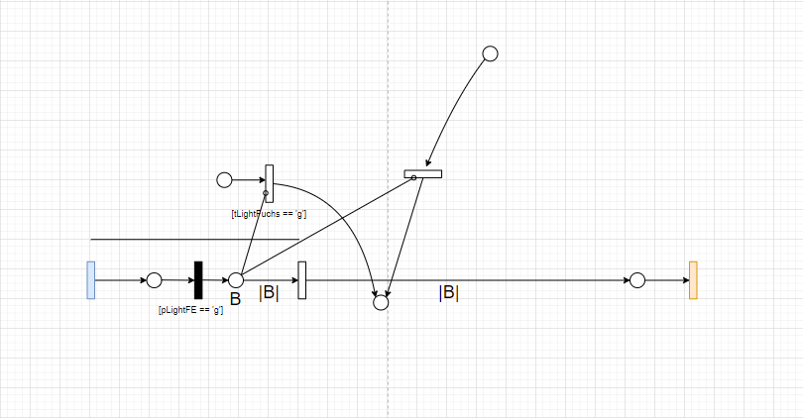
Pedestrians
Simulation Project - Team D
Milestone #3 - Conceptual Model

Slide 16
02
The Assumptions
Simulation Project - Team D
Milestone #3 - Conceptual Model
An overview of the assumptions made

Slide 17
The Assumptions
Simulation Project - Team D
Milestone #3 - Conceptual Model
01
We assume all the motor vehicles are of the same type.
04
We assume there are no major changes in the behavior of cars and pedestrians between different years
02
We assume all pedestrians and cyclists behave in the same way
05
When trams and cars both come together, trams are given higher precedence.
03
Pedestrians go in only one direction. We will model different sources for each of the possible directions.

Slide 18
03
The Data
Simulation Project - Team D
Milestone #3 - Conceptual Model
The data being measured and used as simulation results

Slide 19
The quantities to be measured (Input)
Simulation Project - Team D
Milestone #3 - Conceptual Model
01
Interarrival times of cars.
04
Tram timings, tram and cars alternation.
02
Number of cars going in each direction.
05
Interarrival times of pedestrians and cyclists
03
Traffic light duration.
06
Time to cross the street

Slide 20
The quantities to be used as simulation results
Simulation Project - Team D
Milestone #3 - Conceptual Model
01
Average cars between source and sink
04
Amount of cars passing through a transition
02
Queue Lengths for each lane
03
Average time the cars takes to travel from source and sink

Slide 21
Experiments
Simulation Project - Team D
Milestone #3 - Conceptual Model
01
Vary traffic light duration.
04
Allow car traffic on the blocked tram line in Leipziger Str.
02
Open traffic lights for each direction in different phases.
05
Overload the system and check the behaviour of the traffic
03
Include a free lane to turn right for cars from Leipziger str. to Erich-Weinert str.
06
Bridge for cars going straight in Erich-Weinert-Straße / Am Fuchsberg

Slide 22
04
So far
Simulation Project - Team D
Milestone #3 - Conceptual Model
Tasks completed and costs incurred so far

Slide 23
Tasks completed so far
✓
✓
✓
✓
✓
✓
Simulation Project - Team D
Milestone #3 - Conceptual Model
Started analyzing the data from previous years
Completed the conceptual model.
Estimate time per work packet.
Started working on the anylogic model
Update work as issues in GitHub.
Started analyzing the data from the city of Magdeburg

Slide 24
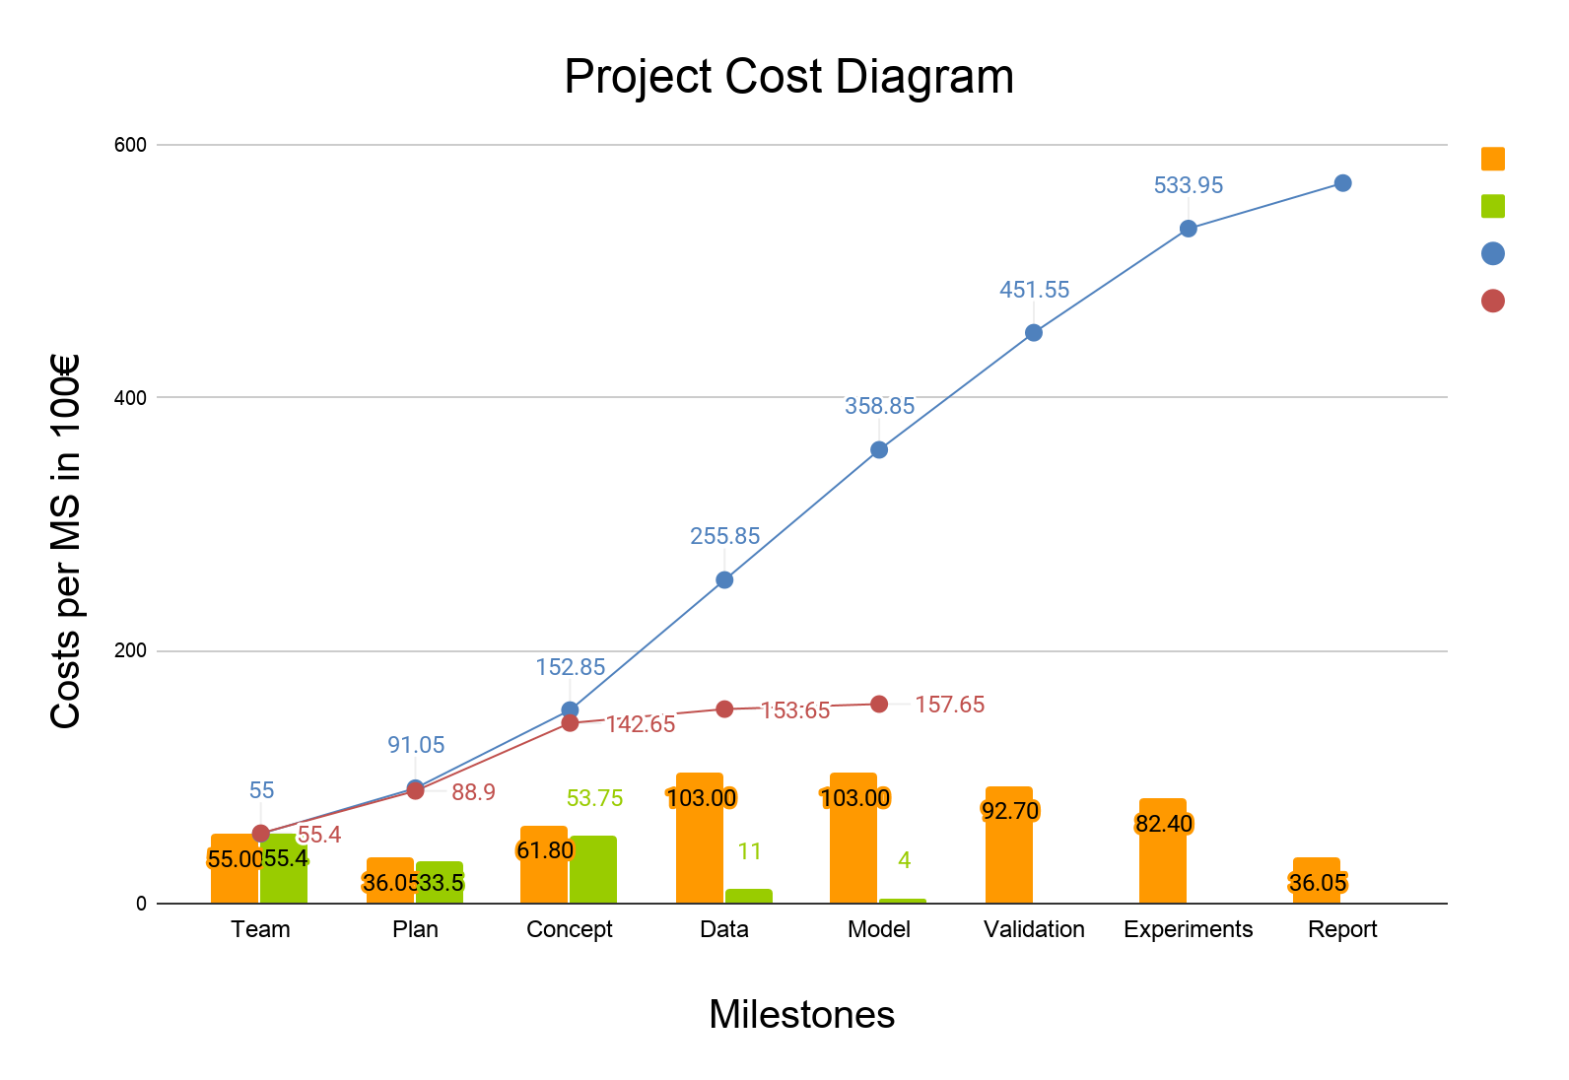
Cost comparison
Simulation Project - Team D
Milestone #3 - Conceptual Model
Estimated cost
Actual cost
Cumulative estimate
Cumulative actual

Slide 25
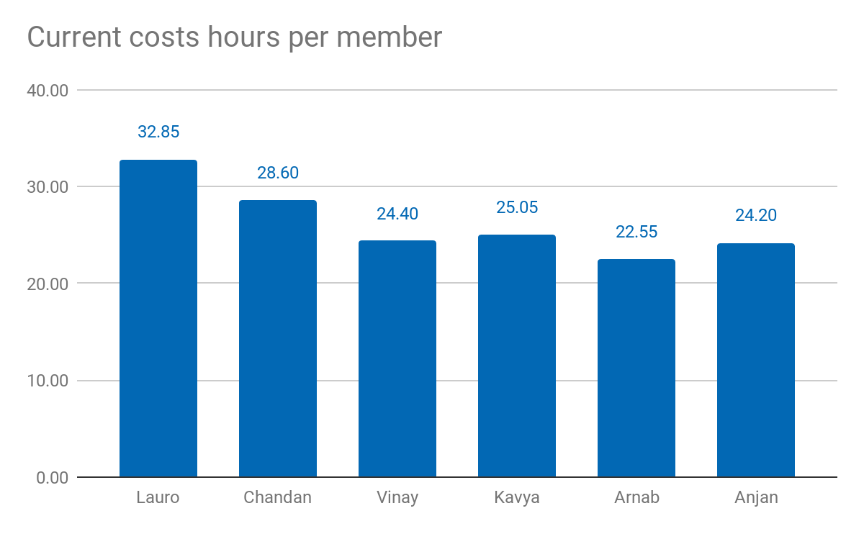
Current costs as % of total cost: 26.28%
Current costs: 15.765,00 €
Simulation Project - Team D
Milestone #3 - Conceptual Model

Slide 26
Lessons learned
01
02
03
04
05
Simulation Project - Team D
Milestone #3 - Conceptual Model
Have a proper justification for each slide
Be agile with the planning
Prepare documentations for each milestone
Add only the necessary content on the slides
Update worksheet evenly throughout the week

Slide 27
05
Thank you!
Simulation Project - Team D
Milestone #3 - Conceptual Model
Questions?

